Slide 1


Parents welcome booklet

Slide 2
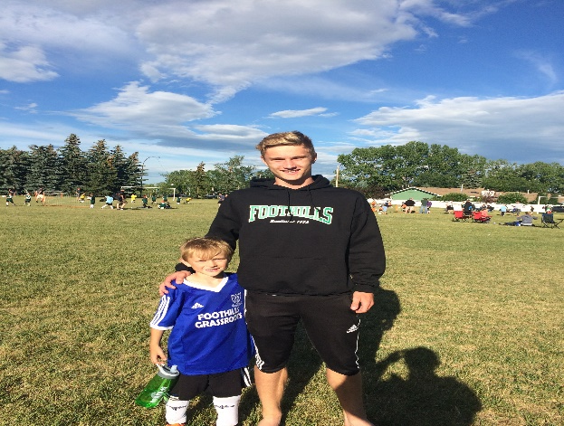
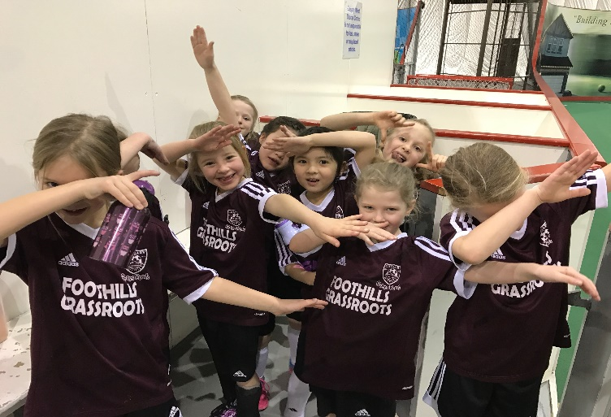
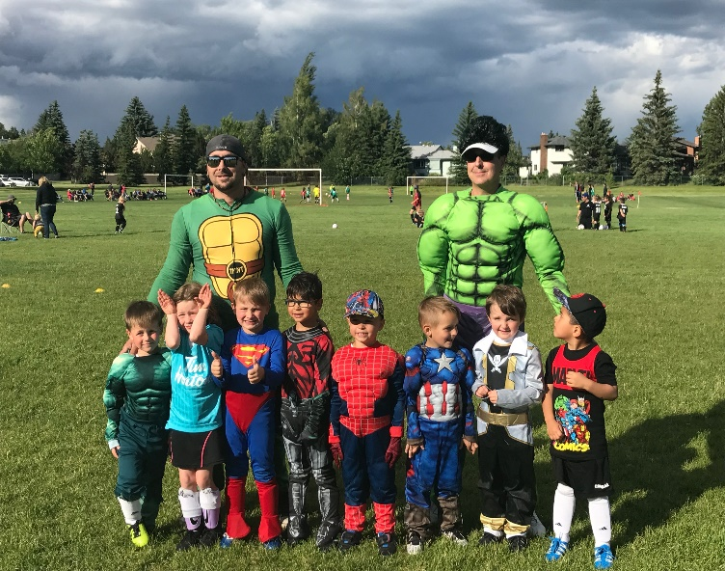
What to expect during the season
Trained Foothills coaches who are available to help and support both your child and your coach.
Players building new friendships through soccer and team experiences.
Coaches who are super cool and WILL become your child's new super hero.

Slide 3
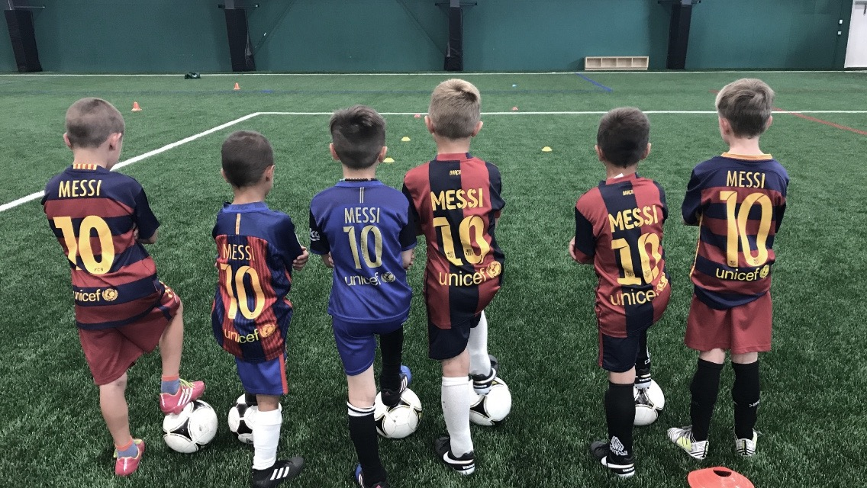
We want our young players to…..
Own the Ball before you share the ball
Encourage your child to
Dribble the ball
Stay on the ball
Enjoy the ball
Don’t encourage kicking the ball away or shouting ‘good boot’
DRIBBLE, DRIBBLE DRIBBLE

Slide 4

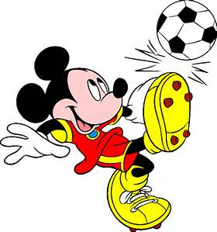
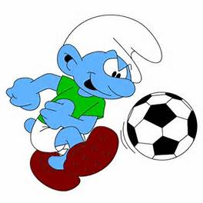
Stage 2
U6-u8
Stage 1
U4 – u6
Physical – Develop the ABCs of movement: agility, balance, co-ordination and speed, as well as running, jumping, twisting, kicking, throwing and catching.
Technical – Movement exercises/games designed to promote a feel for the ball: gaining ball control in receiving passes, dribbling, passing less than 25m,
Tactical – Small children are egocentric – playing the ball is the most important objective. However, they now need to be introduced to co-operation between players. They gain understanding of the game through playing situations.
Mental – Basic awareness of environment to build game intelligence and decision making.
Physical – Provide the environment for learning proper fundamental movement skills such as running, jumping, twisting, kicking, throwing and catching.
Technical – The player and the ball: Running with the ball, dribbling, controlling, kicking and shooting.
Tactical – None.
Social– Fun, fascination, and passion for play.

Slide 5

‘Why’ LTPD:
• Eliminates gaps in the player development system.
• Guides planning for optimal athlete performance at all stages.
• Provides a framework for program alignment and integration, from volunteer club coaches to national and professional teams.
• Follows scientific principles and practical coaching experiences.
Benefits for players & parents:
• Better understanding of what makes a good soccer program.
• More players learning at their level and having fun.
• Appropriate game and league structures (e.g. size of balls, goals, field etc.).
• More opportunity for players to realize their athletic potential.
• More coaches who are knowledgeable in leading safe, effective practices.
Benefits for coaches & clubs:
• Information and education on effective coaching and practice methods.
• Guidelines for appropriate game structures.
• Guidelines on appropriate competition levels.
• Established pathways for player development for all levels of ability and ambition.
• Affirmation of best practices for coaches and club administrators.

Slide 6
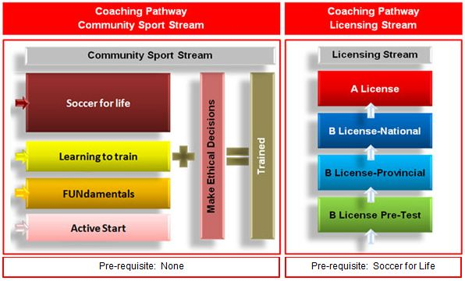



Canada Soccer pathway

Slide 7

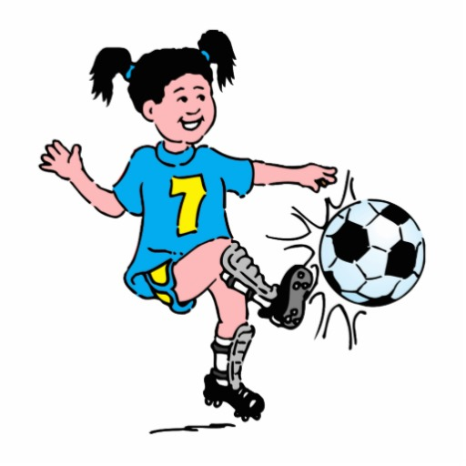
What is Grassroots Soccer ?
To ensure this first experience is fun and enjoyable and revolves around child-friendly soccer. Winning is not the most important thing at this age
To provide an opportunity for players to use their imaginations, be creative and learn through trial and error. Mistakes are OK. Mistakes are a key learning tool.
To offer age and stage appropriate training but ensure, fun is at the forefront
Provide age appropriate games that allow the players to have fun and try new things.
To educate coaches so they will make the soccer experience a challenging, positive and nurturing one for all young players regardless of ability, that leads to Soccer for Life.

Slide 8


The Foothills Pathway
FUNdamentals
FUN & RUN with the ball
Learning Games
1v1 Player
Solo Artist
Attack & Defense
Changing Direction
Learning Games
Creative Decision Maker
Dribble or Pass?
Pressure or Cover?
Decision Making Games
Group Player
Advancing Technical Skills
Working in Units
Managing the Growth Curve
Tactical Understanding
Applying Skill in Game Situations
Developing Roles
Building the Athlete
The Competition
Training to compete
Refining Technical, Tactical, Physical excellence
Preparing for the Future
U4-U8
Focus
U9 AND INTO THE ACADEMY

Slide 9

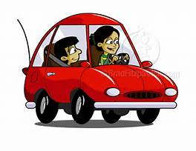


Expectations as a parent
I Loved watching you play
You worked really hard today
Play at Home
Well played Guys..
Dribble , Dribble
Foothills Fc Parents

Slide 10

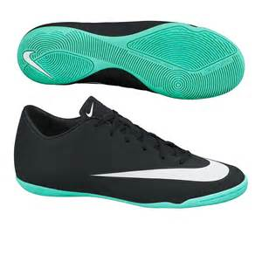

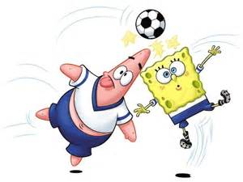
What do our players need ?
Good Indoor shoes
Bottle of water not pop.
Jerseys, shorts & socks will be provide by Foothills
Be ready for the fun

Slide 11




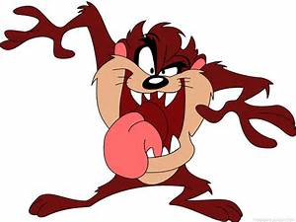
Player expectations ?
Listen to coaches and team mates
Try your best
New friendships
Be ready for a challenge

Slide 12



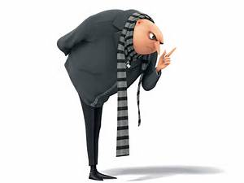

Coach Expectations
NO lines
NO shouting instructions
Motivated to just play
Development & Fun over winning

Slide 13

What training do coaches receive ?
Lets go …
It’s FREE
We offer FREE national coach certification courses to all our Grassroots coaches that are age specific and cover all aspects of child development.
Weekly game/activity ideas for the coaches that are email every Monday
Mentorship through the season We are here to help and support coaches

Slide 14



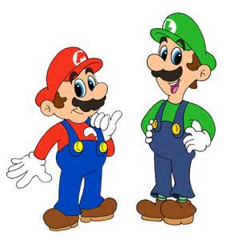
Foothills Expectations
Making new friends
Learning new skills
Team work
Physical literacy games

Slide 15
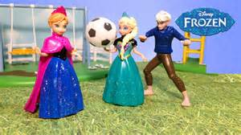


Free skills u8 night
Technique sessions
Skills rotation
Variety of games
Basic soccer skills
Foothills trainers
Coaches welcome
Play with new players
Goals galore
Dribbling fun
Standard weekly sessions

Slide 16
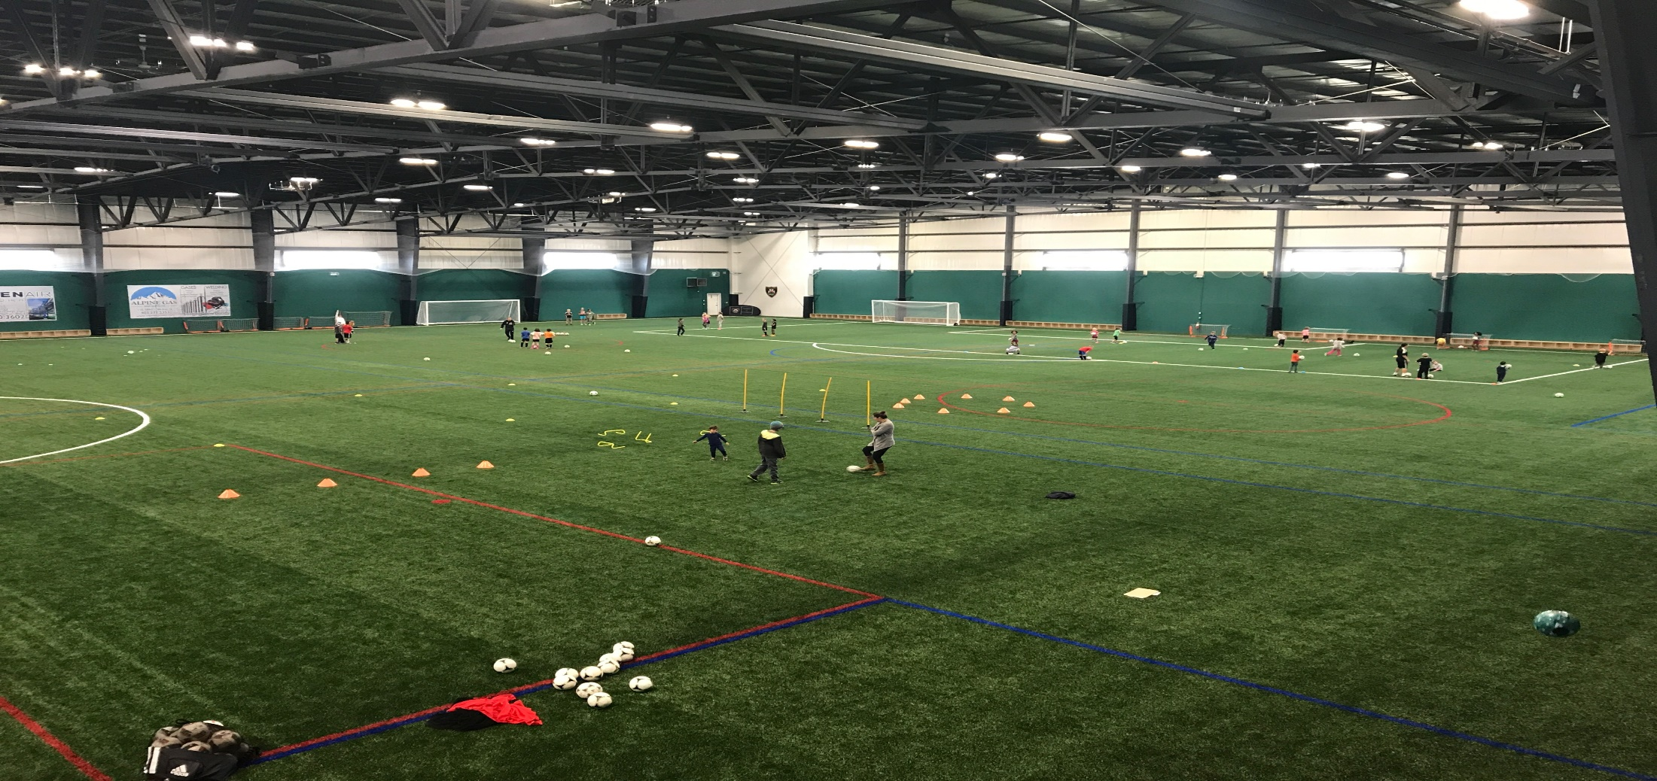
The Future and new home
The Largest indoor turf pitch in Alberta

Slide 17
What’s next after Grassroots ?
Provincial
Programs
U12
T1
U13-U16
T1
U13-U16
T1
U18
Gen NEXT
University
Professional
U9/U10
Tier A-D
U12
Tier 2/3
U13-U16
DA T2/3
U13-U16
DA T2/3
U18
Tier 2/3
PDL/UWS
National
Teaml
U12
Tier 4-6
U13-U16
T4-6
U13-U16
T4-6
U18
T4-6
Adult
Soccer 4 Life
From U9+ teams are now formed after a try out process. No players journey will be the same

